Slide 1
UNIT II
Program design and analysis
Software components.
Representations of programs.
Assembly and linking.
SITE

Slide 2
Models of programs
Source code is not a good representation for programs:
  clumsy;
  leaves much information implicit.
Compilers derive intermediate representations to manipulate and optiize the program.
SITE

Slide 3
Data flow graph
DFG: data flow graph.
Does not represent control.
Models basic block: code with no entry or exit more precisely with one entry and exit
Describes the minimal ordering requirements on operations.
SITE

Slide 4
Single assignment form
x = a + b;
y = c - d;
z = x * y;
y = b + d;
original basic block
x = a + b;
y = c - d;
z = x * y;
y1 = b + d;
single assignment form
SITE

Slide 5
Data flow graph
x = a + b;
y = c - d;
z = x * y;
y1 = b + d;
single assignment form
a
b
c
d
+
-
y
x
*
+
z
y1
DFG
SITE

Slide 6
DFGs and partial orders
Partial order:
a+b, c-d; b+d x*y
Can do pairs of operations in any order.
a
b
c
d
+
-
y
x
*
+
z
y1
SITE

Slide 7
Control-data flow graph
CDFG: represents control and data.
Uses data flow graphs as components.
Two types of nodes:
  decision;
  data flow.
SITE

Slide 8
Data flow node
Encapsulates a data flow graph:
Write operations in basic block form for simplicity.
x = a + b;
y = c + d
SITE

Slide 9
Control
cond
T
v1
v4
value
v2
v3
F
Equivalent forms
SITE

Slide 10
CDFG example
if (cond1) bb1();
else bb2();
bb3();
switch (test1) {
case c1: bb4(); break;
case c2: bb5(); break;
case c3: bb6(); break;
}
T
cond1
bb1()
F
bb2()
bb3()
test1
c3
c1
c2
bb4()
bb5()
bb6()
SITE

Slide 11
for loop
for (i=0; i<N; i++)
loop_body();
for loop
i=0;
while (i<N) {
loop_body(); i++; }
equivalent
i=0
i<N
F
T
loop_body()
SITE

Slide 12
Assembly and linking
Last steps in compilation:
HLL
compile
assembly
HLL
assembly
assemble
HLL
assembly
link
executable
link
SITE

Slide 13
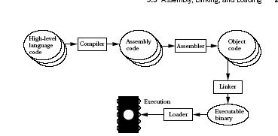

Slide 14
Multiple-module programs
Programs may be composed from several files.
Addresses become more specific during processing:
  relative addresses are measured relative to the start of a module;
  absolute addresses are measured relative to the start of the CPU address space.
SITE

Slide 15
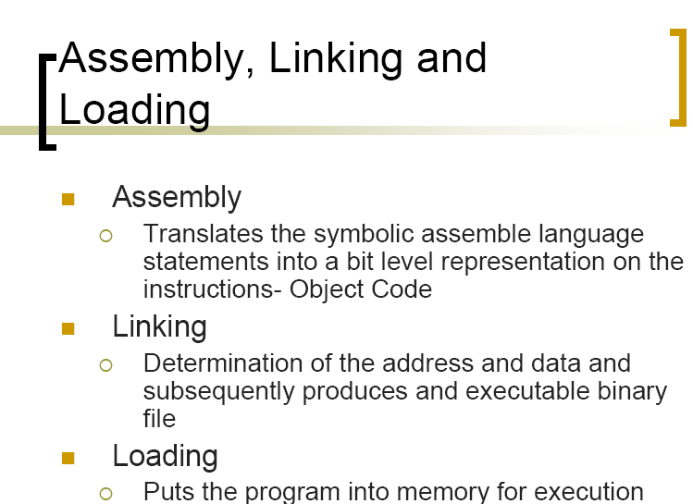
SITE

Slide 16
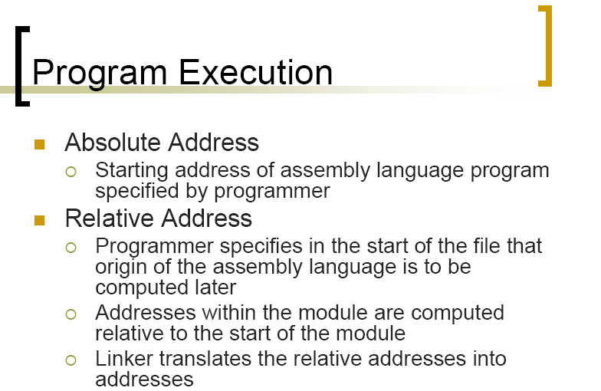
SITE

Slide 17
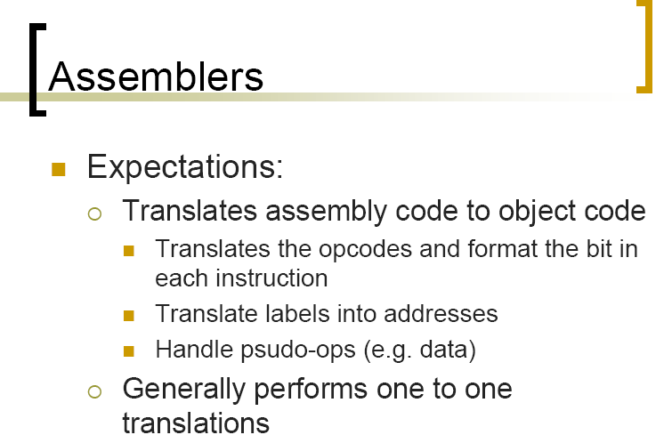
SITE

Slide 18
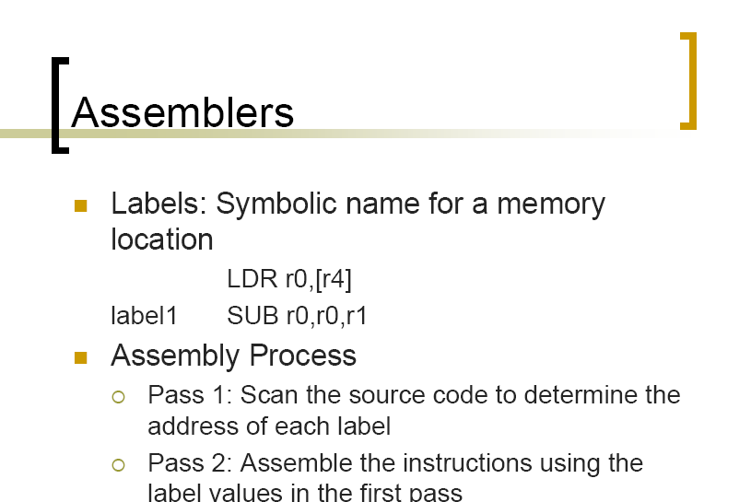
SITE

Slide 19
SITE

Slide 20
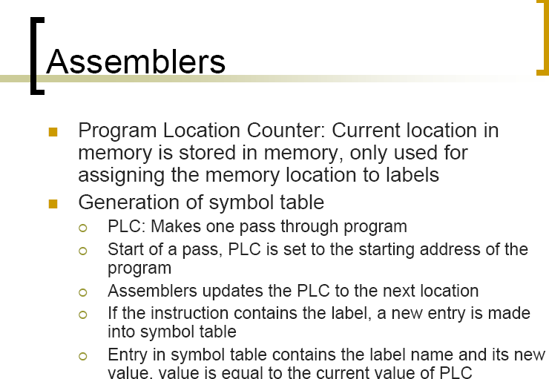
SITE

Slide 21
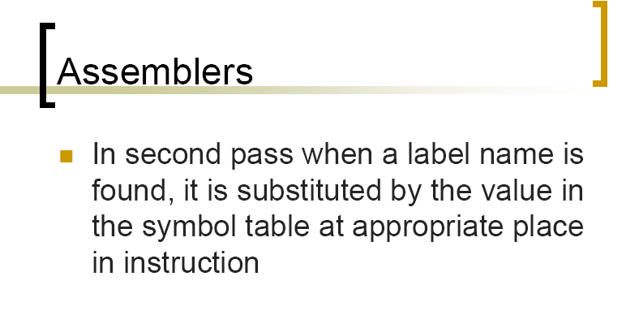
SITE

Slide 22
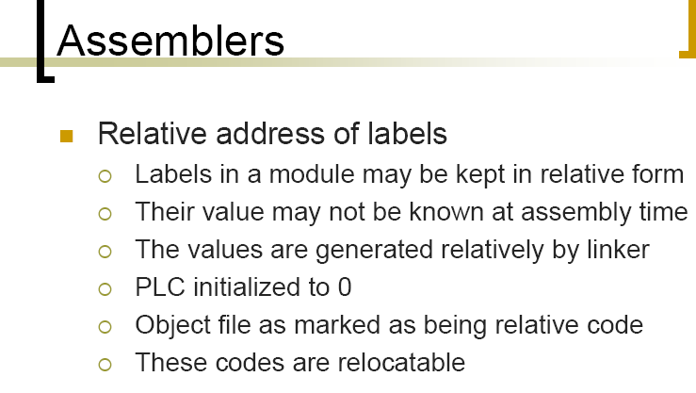
SITE

Slide 23
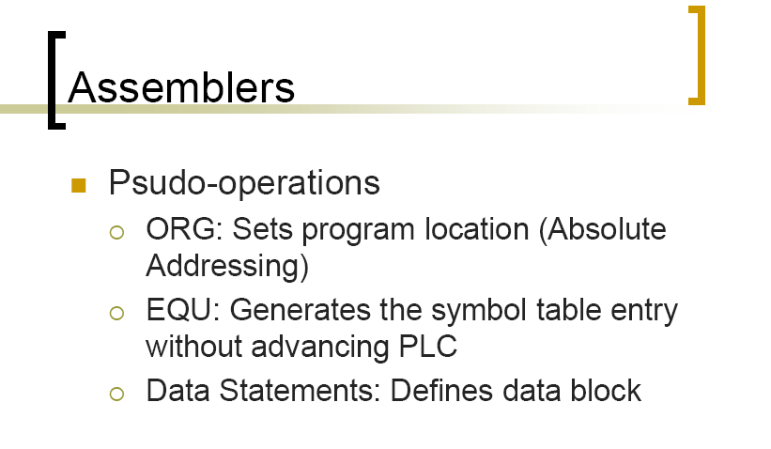
SITE

Slide 24
GENERATING A SYMBOL TABLE
ORG 100
PLC = 100 label1 ADR r4,c
LDR r0,[r4]
PLC = 108 label2 ADR r4,d
LDR r1,[r4]
PLC = 116 label3 SUB r0,r0,r1
label1 100 label2 108 label3 116 Symbol table
SITE

Slide 25
ORG 200
p1 ADR r4,a
LDR r0,[r4]
ADR r4,e
LDR r1,[r4]
ADD r0,r0,r1
CMP r0,r1
BNE q1
p2 ADR r4,e

Slide 26
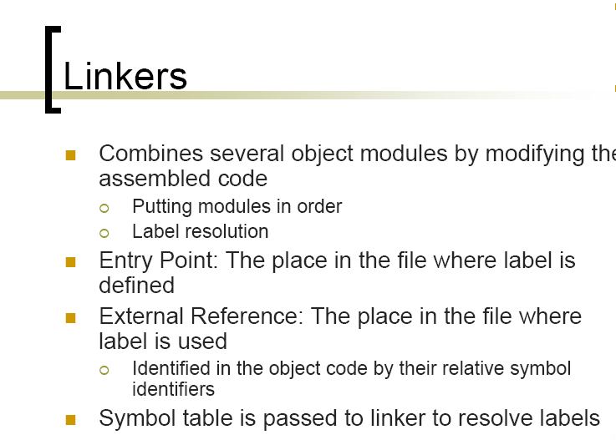
SITE

Slide 27
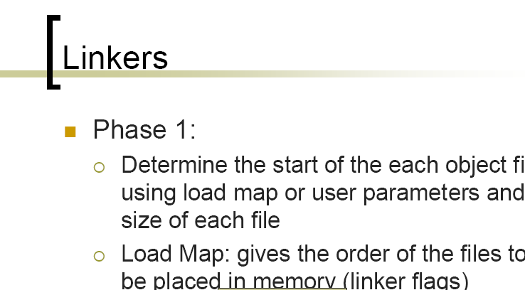
SITE

Slide 28
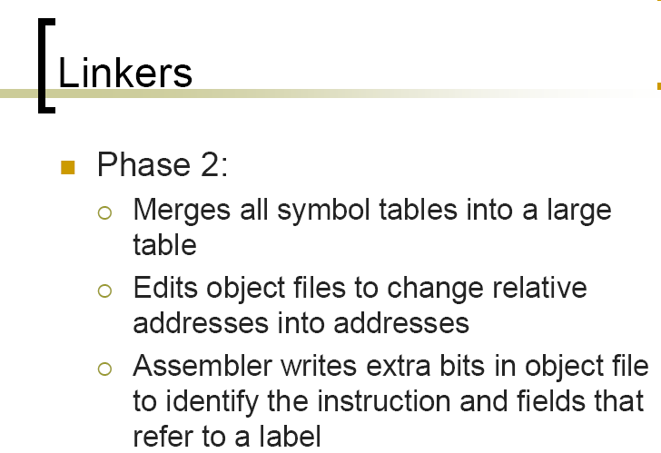
SITE

Slide 29
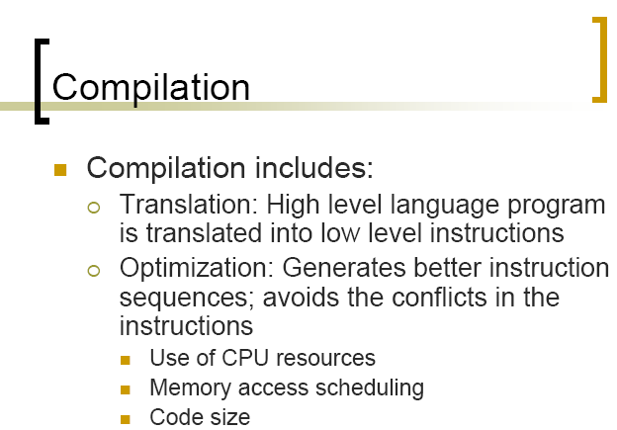
SITE

Slide 30
Basic compilation phases
HLL
parsing, symbol table
machine-independent
optimizations
machine-dependent
optimizations
assembly
SITE

Slide 31
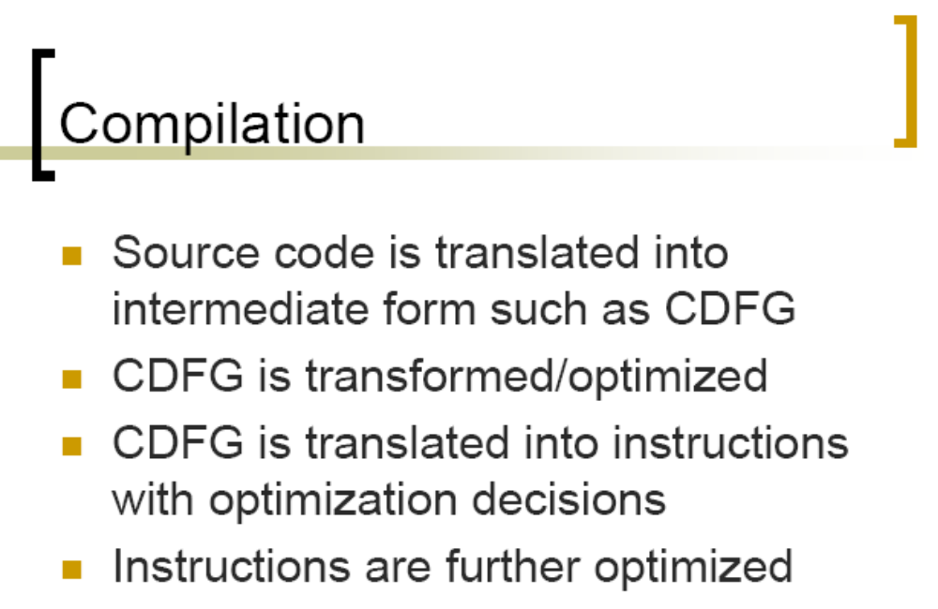
SITE

Slide 32
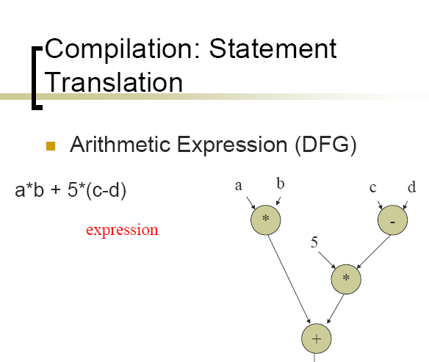
SITE

Slide 33
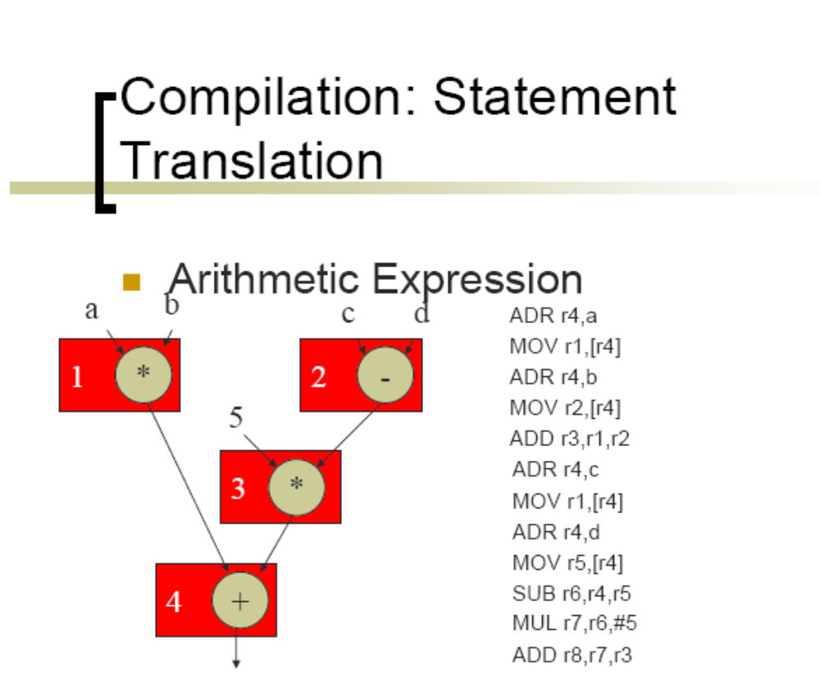
SITE

Slide 34
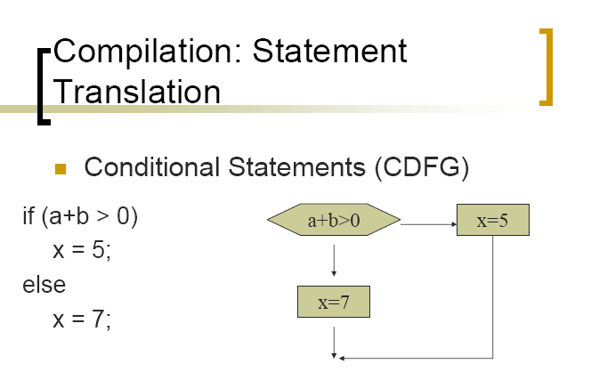
SITE

Slide 35
Control code generation, cont’d.
ADR r5,a
LDR r1,[r5]
ADR r5,b
LDR r2,b
ADD r3,r1,r2
BLE label3
1
2
a+b>0
x=5
3
x=7
LDR r3,#5
ADR r5,x
STR r3,[r5]
B stmtent
LDR r3,#7
ADR r5,x
STR r3,[r5]
stmtent ...
SITE

Slide 36
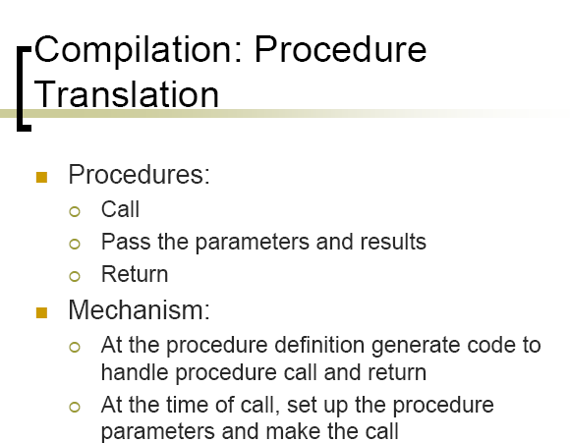
SITE

Slide 37
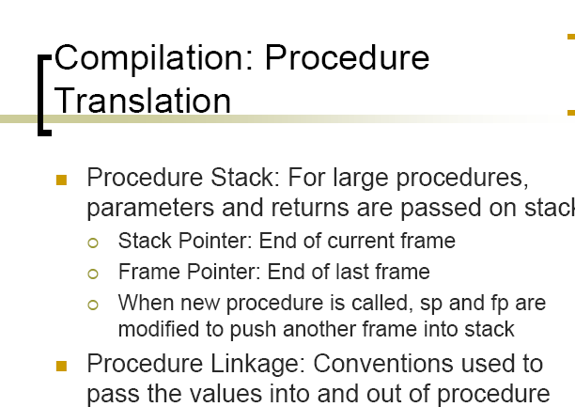
SITE

Slide 38
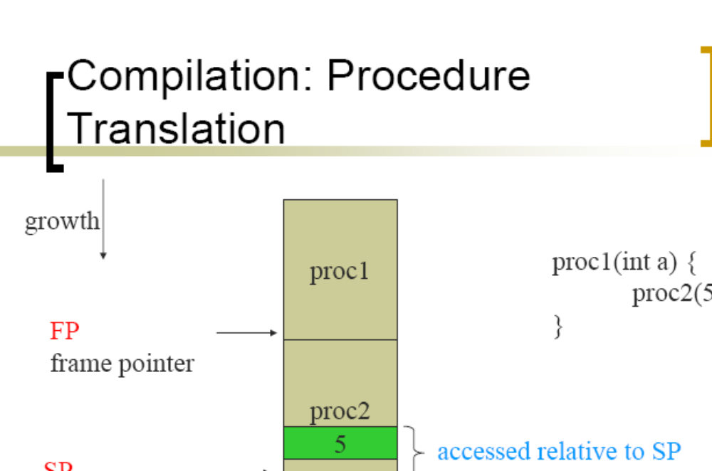
SITE

Slide 39
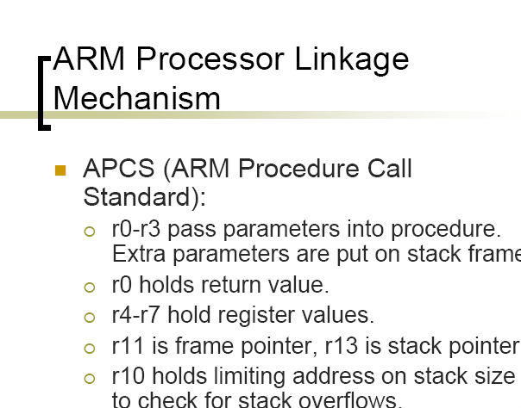
SITE

Slide 40
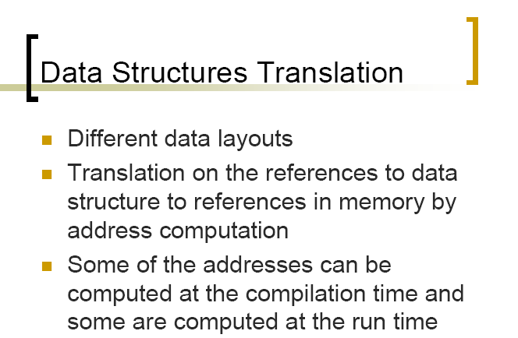
SITE

Slide 41
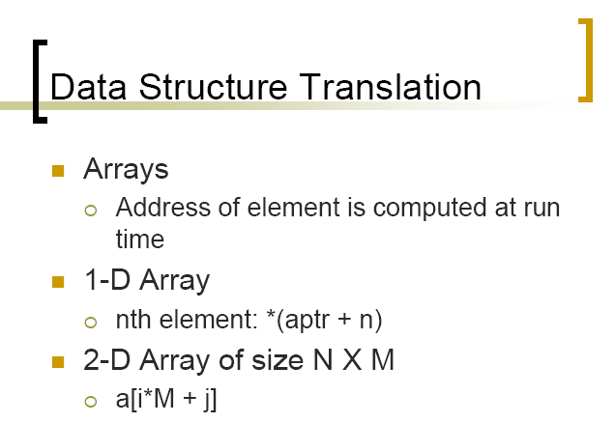
SITE

Slide 42
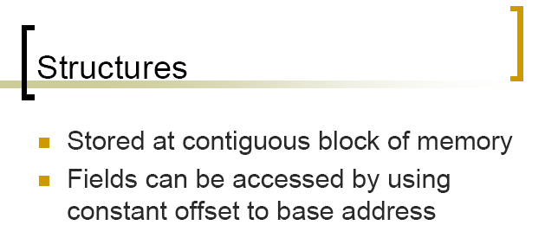
SITE

Slide 43
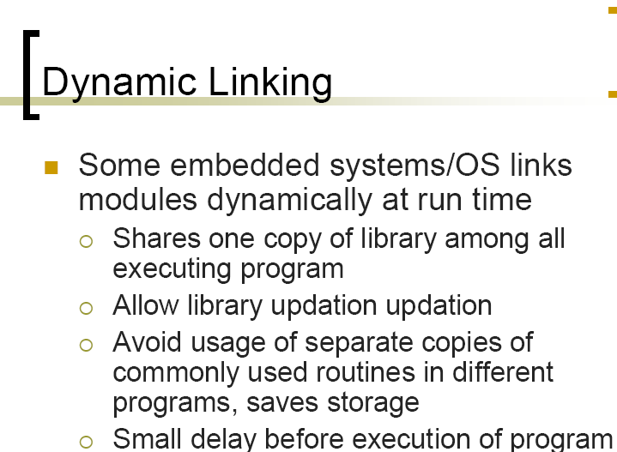
SITE

Slide 44
Procedure linkage
Need code to:
  call and return;
  pass parameters and results.
Parameters and returns are passed on stack.
  Procedures with few parameters may use registers.
SITE

Slide 45
Procedure stacks
growth
proc1
proc1(int a) {
proc2(5);
}
FP
frame pointer defines
The end of last frame
proc2
5
accessed relative to SP
SP
stack pointer defines
The end of current frame
SITE

Slide 46
ARM procedure linkage
APCS (ARM Procedure Call Standard):
  r0-r3 pass parameters into procedure. Extra parameters are put on stack frame.
  r0 holds return value.
  r4-r7 hold register values.
  r11 is frame pointer, r13 is stack pointer.
  r10 holds limiting address on stack size to check for stack overflows.
SITE

Slide 47
Data structures
Different types of data structures use different data layouts.
Some offsets into data structure can be computed at compile time, others must be computed at run time.
Can be represented in arrays
One dimensional array a[i]
Two dimensional array a[i,j]
SITE

Slide 48
One-dimensional arrays
C array name points to 0th element:
a
a[0]
a[1]
= *(a + 1)
a[2]
SITE

Slide 49
Two-dimensional arrays
row-major layout:
a[0,0]
a[0,1]
M
...
N
...
a[1,0]
a[1,1]
= a[i*M+j]
SITE

Slide 50
Structures
Fields within structures are static offsets:
aptr
field1
struct {
int field1;
char field2;
} mystruct;
struct mystruct a, *aptr = &a;
4 bytes
field2
*(aptr+4)
SITE

Slide 51
Program optimization

Slide 52
Expression simplification
Constant folding:
  8+1 = 9
Algebraic:
  a*b + a*c = a*(b+c) distributive law
Strength reduction:
For (i =0;i<8+1;i++)
SITE

Slide 53
Dead code elimination
Dead code:
#define DEBUG 0
if (DEBUG) dbg(p1);
Can be eliminated by analysis of control flow, constant folding.
There is no else clause so the compiler totally eliminate the if statement
0
0
1
dbg(p1);
SITE

Slide 54
Procedure inlining
Eliminates procedure linkage overhead:
int foo(a,b,c) { return a + b - c;}
function definition
z = foo(w,x,y);
function call
⇨
z = w + x - y;
inlining result
SITE

Slide 55
Loop transformations
Goals:
  reduce loop overhead;
  increase opportunities for pipelining;
  improve memory system performance.
SITE

Slide 56
Loop unrolling
Reduces loop overhead, enables some other optimizations.
for (i=0; i<N; i++)
a[i] = b[i] * c[i]; assume N=4
a[0]=b[0]*c[0]; …….
⇨
for (i=0; i<2; i++) {
a[i*2] = b[i*2] * c[i*2];
a[i*2+1] = b[i*2+1] * c[i*2+1];
}
SITE

Slide 57
Loop fusion and distribution
Fusion combines two loops into 1:
for (i=0; i<N; i++) a[i] = b[i] * 5;
for (j=0; j<N; j++) w[j] = c[j] * d[j];
⇨ for (i=0; i<N; i++) {
a[i] = b[i] * 5; w[i] = c[i] * d[i];
}
Loop Distribution breaks one loop into multiple loops.
Changes optimizations within loop body.
SITE

Slide 58
Loop tiling
Breaks one loop into a nest of loops.
Inner loop performs operations on the subset of data.
Changes order of accesses within array.
  Changes cache behavior.
SITE

Slide 59
Loop tiling example
for (i=0; i<N; i++)
for (j=0; j<N; j++)
c[i] = a[i,j]*b[i];
for (i=0; i<N; i+=2)
for (j=0; j<N; j+=2)
for (ii=0; ii<min(i+2,N); ii++)
for (jj=0; jj<min(j+2,N); jj++)
c[ii] = a[ii,jj]*b[ii];
SITE

Slide 60
Array padding
Add array elements to change mapping into cache:
a[0,0]
a[0,1]
a[0,2]
a[0,0]
a[0,1]
a[0,2]
a[0,2]
a[1,0]
a[1,1]
a[1,2]
a[1,0]
a[1,1]
a[1,2]
a[1,2]
before
after
SITE

